Slide 1

Northwind Traders Business Performance Analysis
Presented By K Jevaneswari Aspiring Data Analyst

Slide 2
Data Source & Structure
Customers – Customer company and geographic details for segmentation analysis.
Employees – Employee information for workforce performance evaluation.
Orders – Order-level transactional data for sales trend analysis.
Order Details – Product-level sales data including quantity, price, and discount.
Products – Product catalog with pricing and stock information.
Suppliers – Vendor details for supply chain analysis.
Shippers – Shipping company data for logistics performance.
Categories – Product classification for category-wise analysis.
Source: Northwind Traders Database
Period: 1994–1996
Model: Star Schema
Fact: Order Details – line-level sales transactions Orders: Order header (date, customer, employee, ship info)
Dimensions: Customers, Products, Categories, Suppliers, Employees, Shippers
Scale: 790 Orders | 2,155 Details | 90 Customers | 77 Products | 29 Suppliers

Slide 3
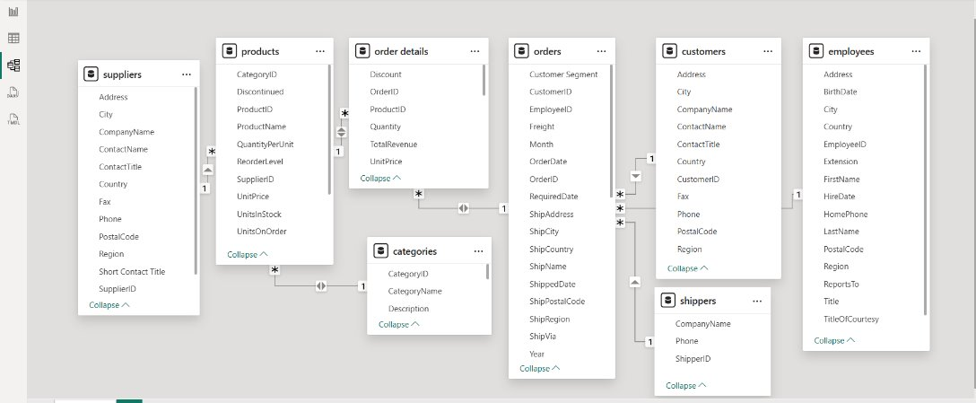
Data Modelling

Slide 4

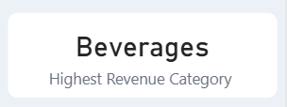

Revenue Concentration Insight
• Total Revenue: $1.27M • Beverages is the highest revenue category
59% of revenue is generated by the top 20% of products, indicating strong revenue concentration and dependency risk.

Slide 5
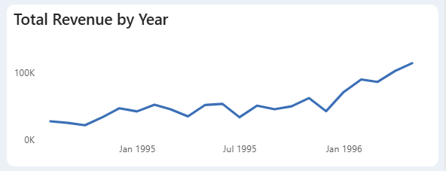
Revenue Growth Trend
Revenue shows an upward trend from 1994 to 1996
Minor fluctuations but overall positive growth trajectory
Insight:
Revenue exhibits stable growth with increasing momentum toward 1996.

Slide 6
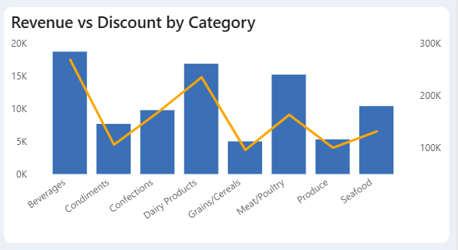
Discount Strategy Analysis
Some high-discount categories generate relatively lower revenue
Revenue response to discounts varies significantly across categories
Insight:
Discount effectiveness is inconsistent, highlighting opportunities for strategic price optimization.

Slide 7
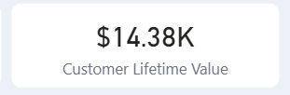
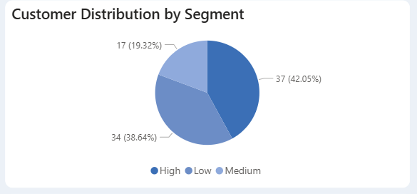
Customer Value Analysis
Total Customers: 88
42% are High-Value Customers
Retention Rate: 95%
Average Customer Lifetime Value: $14.38K
Insights:
A high retention rate of 95% combined with a significant proportion of high-value customers indicates strong customer loyalty and stable recurring revenue potential.

Slide 8
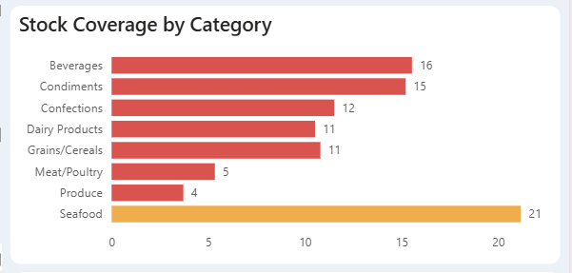
Inventory Risk Identification
Seafood shows 21 days of stock coverage, indicating potential overstock risk
Produce has only 4 days of coverage, indicating possible stockout risk
Insights:
Significant variation in stock coverage across categories suggests inventory imbalance, increasing both holding cost risk and potential lost sales.

Slide 9
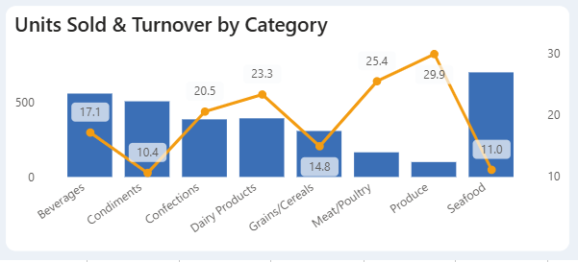
Inventory Efficiency
Inventory Turnover Ratio: 16.45
Total Units Sold: 51K
8 Active Product Categories
Insights:
A turnover ratio of 16.45 indicates healthy overall inventory movement; however, efficiency may vary across categories, suggesting uneven stock utilization.

Slide 10
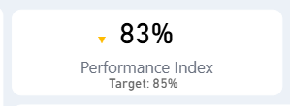
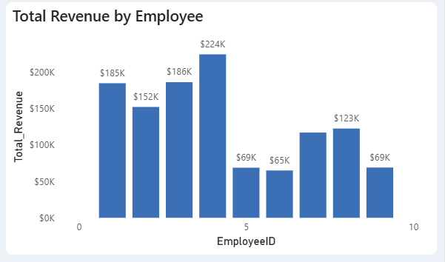
Workforce Productivity
Performance Index: 83% (Target:85%)
On-Time Delivery Rate: 96%
Revenue contribution varies across employees
Insights:
While operational delivery performance is high at 96%, the overall performance index remains slightly below target, indicating potential productivity gaps across the workforce.

Slide 11
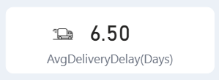
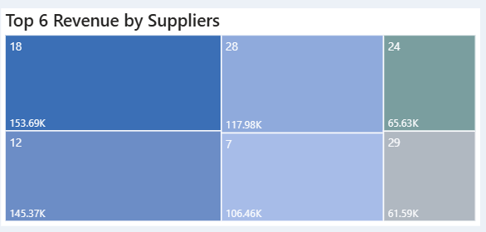
Supplier Performance Analysis
Total Suppliers: 29
Average Delivery Delay: 6.5 days
Revenue is concentrated among a small group of key suppliers
Insights:
Revenue concentration among key suppliers combined with an average delay of 6.5 days indicates supply chain dependency risk and potential service disruption.

Slide 12
Based on the analysis, the following strategic initiatives are recommended:
Diversify revenue streams to reduce dependency on top-performing products
Implement category-specific discount optimization
Align inventory levels with demand patterns
Strengthen supplier performance monitoring and diversification
Enhance workforce productivity and customer engagement through targeted performance strategies.

